Slide 1

The Power
of Carbon
Nanotubes.
___________________
A new way to perform

Slide 2
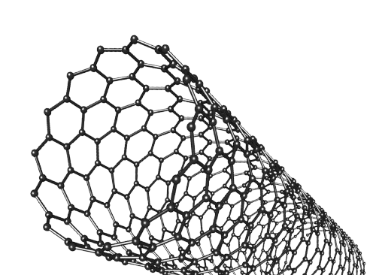
Introduction
___________________
A growing technology
Let’s dive into our papers !
LOTS OF NEW APPLICATIONS:
Transistors
Infrared
…

Slide 3
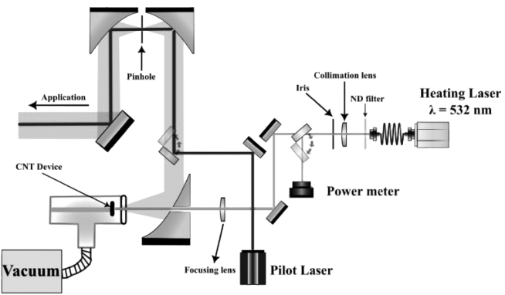

Paper 1: Laser-heated carbon-nanotube blackbody source for infrared spectroscopy
CHALLENGE.
Standard IR sources struggle for very small sample
Limits spatial resolution, signal quality
SOLUTION.
VACNTs, heated by a laser to ~3000k
Near-perfect IR emissivity
High melting point (>3000K)
Small & bright emission spot (~150 µm)
REVIEW.
Like: “simple” solution, relatively low cost
Dislike: Preliminary results (temperature uncertainty ); requires vacuum operation

Slide 4
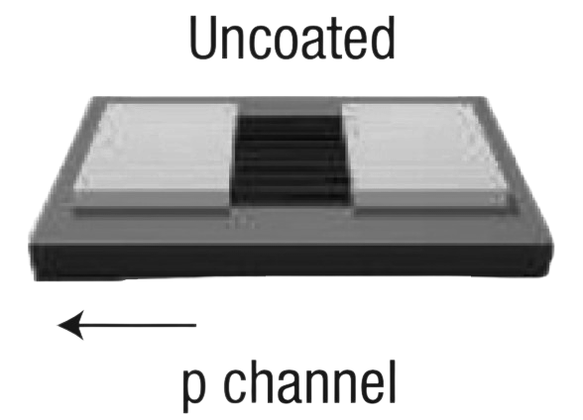
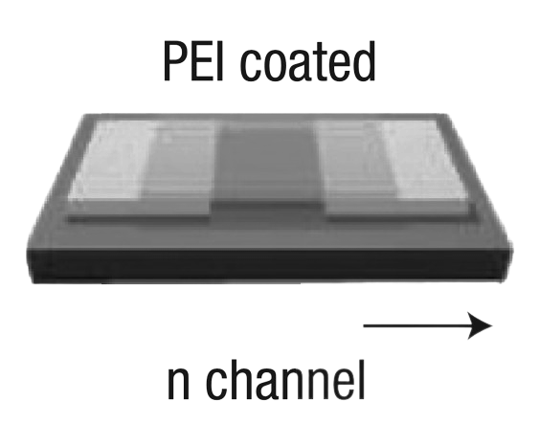
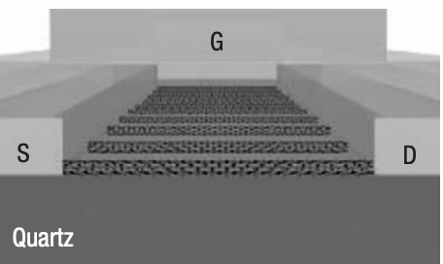
Paper 2: High-performance electronics using dense, perfectly aligned arrays of single-walled carbon nanotubes
Forest of SWCNTs as semiconductor
Full CMOS and PMOS logic gates on mechanically flexible transistors
Easy switching between p- and n-channel FETs
Bridging nanotube physics with silicon fabrication
REVIEW.
Like: Versatile device demonstrations: PMOS/CMOS logic gates, RF transistors, flexible plastic transistors
Dislike: Quartz‐only growth: not standard in silicon fabs—adding a specialized step

Slide 5

Thank
You.
___________________
Alexandre Kiss • Pierre Parvex • Samira Tscherrig • Benjamin Deprez • Fanny Ghez

